Slide 1
MPI and Parallelism
Andrew Kirby, Tyson Limato

Slide 2
Overview
• What is MPI?
• Why use MPI?
• Introducing MPI for Python
• What is a Multilayer Perceptron?
• What Tasks are we Parallelizing?
• What is Model Parallelism and how do we use MPI for Python to achieve it?
• Basic CuPy for GPU Parallelism

Slide 3
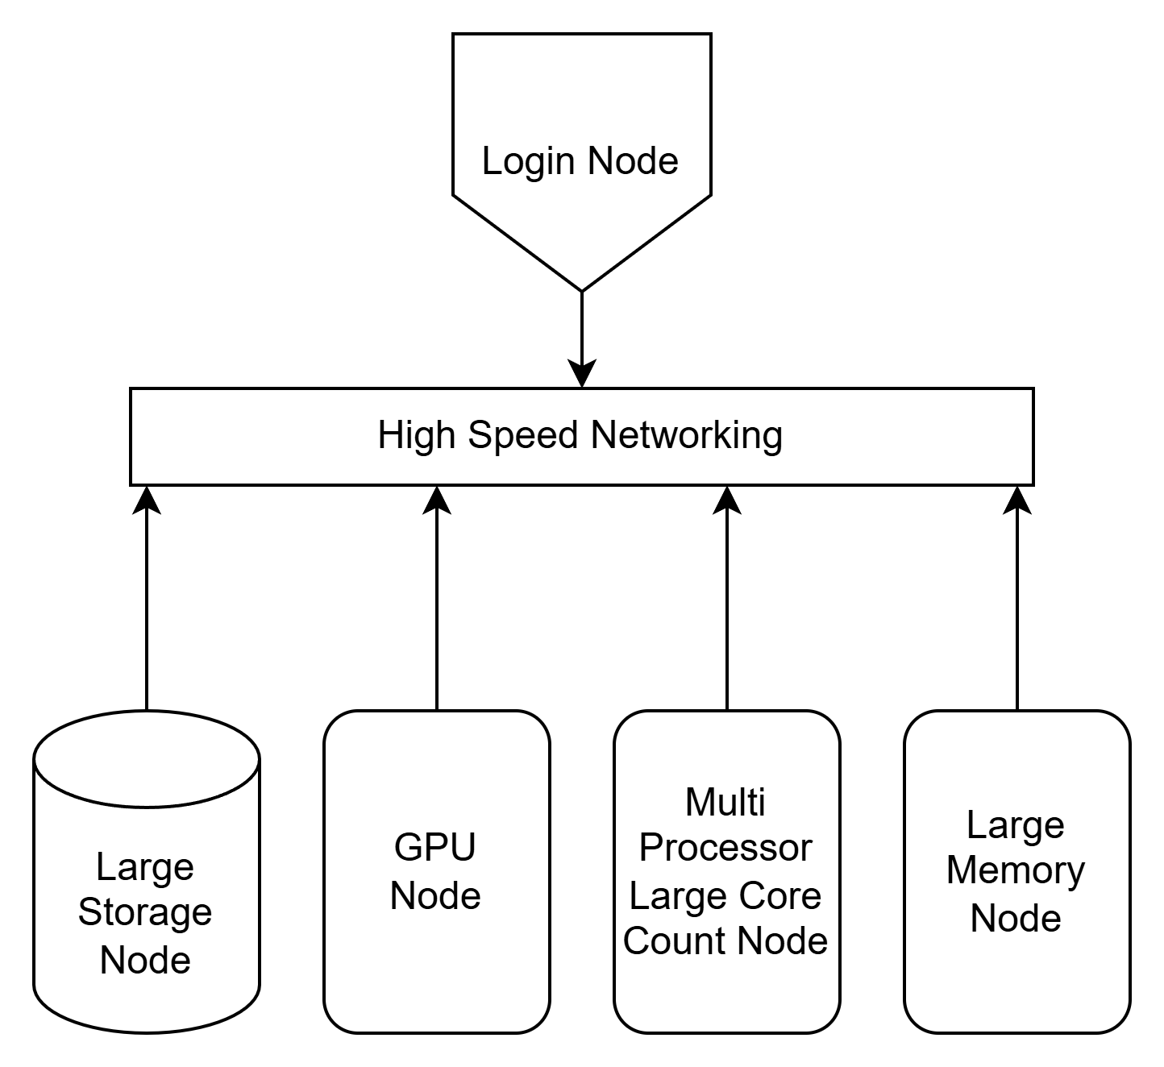
What is MPI?
A message-passing library specification
Extended message-passing model
not a language or compiler specification
not a specific implementation or product
For parallel computers, clusters, and heterogeneous networks
Designed to provide access to advanced parallel hardware for
end users
library writers
tool developers
Heterogeneous Cluster

Slide 4
Why use MPI?
MPI (and its many variants) provides a powerful, efficient, and portable way to express parallel programs
MPI was explicitly designed to enable libraries and to leverage multiple different types of computing architectures.
In the growing field of Artificial intelligence, the industry must parallelize large models across many devices
In Atmospheric science, complex weather modeling requires multiple CPUs and large memory arrays

Slide 5
MPI for Python
For this session we will be using MPI for Python (MPI4Py) in tandem with a Multilayer Perceptron Model (MLP) to illustrate the advantages and drawbacks of..
serial programming
parallel CPU programming
basic GPU parallelism
We'll first cover the basics of a multilayer perceptron that we will use to predict housing prices.
We will then cover how we go about parallelizing our MLP's training

Slide 6
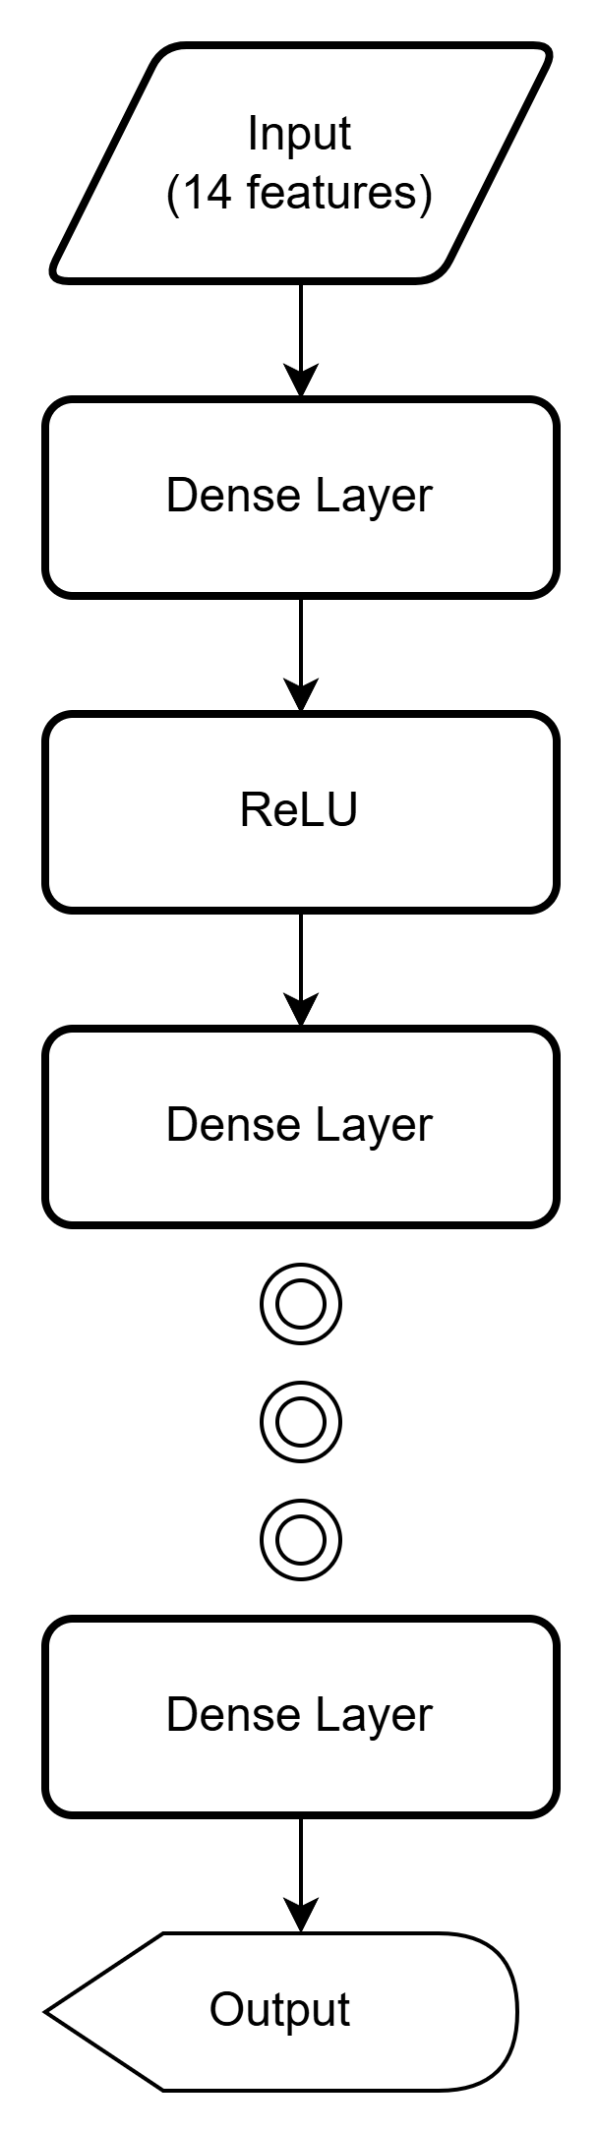
What is a Multilayer Perceptron (MLP)?
An MLP is a type of feedforward neural network.
It consists of multiple layers of neurons:
Input layer – receives raw data.
Hidden layers – perform transformations.
Output layer – produces predictions.
Each layer is typically a:
Dense (fully connected) layer
Followed by a nonlinear activation like ReLU.
To the left is an example architecture.

Slide 7
Role of Dense Layers and ReLU
Dense Layer: Every neuron connects to all neurons in the previous layer.
Learns weighted combinations of inputs.
ReLU (Rectified Linear Unit):
Replaces negative outputs with zero: ReLU(x) = max(0, x)
Introduces nonlinearity so the network can model complex patterns.
Stacked Layers Learn Hierarchies:
Early layers: detect low-level patterns.
Later layers: extract more abstract features relevant to the target task.

Slide 8
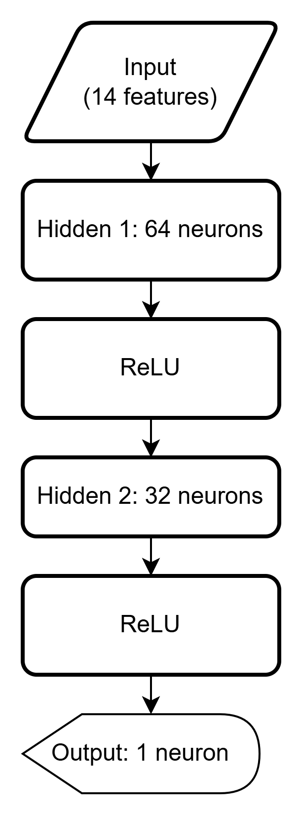
Why Fewer Outputs in Regression Tasks?
Our primary Goal is to predict a single value given various input features with reasonable accuracy. These types of models carry out a regression task.
In machine learning, a regression task involves predicting a continuous numerical value, unlike classification which predicts categories.
Early layers often have many neurons to extract rich features.
Later layers narrow down:
Reduces the feature dimension gradually.
Final layer matches the number of target outputs (e.g., 1 for price).
This bottleneck shape forces the network to compress useful information into a compact form for accurate predictions

Slide 9
Why do we care?
In this exercise we want to build a Multilayer perceptron that, given numerous house listings and 14 different data points, can predict the house price of any house given any 14 inputs
The set of inputs we care about are as follows:
'sqft', 'beds', 'baths', 'age', 'garage', 'stories', 'lot_size', 'distance_to_city', 'crime_rate', 'school_rating', 'has_pool','has_fireplace', 'neighborhood_code', 'year_renovated', and 'price'
All binary options like 'has_pool' are treated with either a 0 or 1 in our data set
The Data being used is a set of 10,000 homes randomly generated from a python script with a set of predefined ranges for each statistic.

Slide 10
What are we using MPI for?
There are two tasks we must parallelize for our Multilayer Perceptron to not be permanently lobotomized:
Task 1: Forward Pass – Predicting with an MLP
Task 2: Backpropagation – Learning from Errors

Slide 11
Forward Pass – Predicting with an MLP
The forward pass is how the MLP makes predictions.
Data flows layer by layer, starting from input:
Compute weighted sum at each neuron:
z = W·x + b
Apply activation function (e.g., ReLU):
a = ReLU(z)
Repeat for each hidden layer.
Final layer produces output prediction ŷ
The output ŷ is then compared to the true label y using a loss function (e.g., Mean Squared Error for regression).
Example:
Input x →
Dense1: z₁ = W₁·x + b₁ → ReLU →
Dense2: z₂ = W₂·a₁ + b₂ → ReLU →
Output: ŷ = W₃·a₂ + b₃

Slide 12
Backpropagation – Learning from Errors
Backpropagation updates the model by computing how much each weight contributed to the error.
Steps:
Compute the loss gradient at the output.
Propagate the gradient backward through each layer:
Use chain rule to compute partial derivatives:
How loss changes with respect to each weight and bias.
Accumulate gradients for each layer.
Update weights with gradient descent:
W = W - η * dW, where η is the learning rate.
Backpropagation ensures:
Lower layers learn features that help upper layers reduce the overall loss.
All layers are updated end-to-end, even if only the output is directly evaluated.

Slide 13
Overview – Pipeline Model Parallelism
Model Parallelism is a technique used in deep learning to split a single large model across multiple devices or processes.
How It Works:
Instead of replicating the entire model on every device (as in data parallelism), the model itself is partitioned into segments.
Each device (or MPI process) is responsible for computing a portion of the model’s layers.
Forward pass: data flows sequentially through each partition.
Backward pass: gradients are computed in reverse and passed back, stage by stage.
Example:
Rank 0 → Layers 1–2 Rank 1 → Layers 3–4 Rank 2 → Layers 5–6

Slide 14
Pros/Cons: Pipeline Model Parallelism
Benefits:
Enables training of very large models that don’t fit in the memory of a single device.
Efficient for deep models with many sequential layers.
Challenges:
Requires synchronization and communication between devices.
May lead to pipeline stalls if not optimized with micro-batching or overlapping.

Slide 15
Pipeline Model Parallelism with MPI
The network is split into N sequential stages, one per MPI rank. (MPI rank being a given CPU Core or Thread)
Each process (rank):
Holds a slice of the MLP model (a few layers).
Only performs forward and backward operations for its assigned layers.
Data flows through the pipeline as micro-batches to maintain parallel throughput.
Key Idea: Each rank performs partial computation and communicates results with neighbors.

Slide 16
Forward Pass – Moving Activations Across Ranks
Rank 0 starts by:
Computing forward activations for the input mini-batch.
Sending the activations to the next rank using MPI.Send.
Intermediate ranks:
Receive activations from the previous rank.
Perform their forward pass on these activations.
Send the result to the next rank.
Final rank:
Receives the last activation.
Computes model output and loss.
All communication uses MPI point-to-point (Send/Recv) for explicit control.

Slide 17
Micro-Batching for Pipelining Efficiency
To avoid idle ranks, the model is trained using micro-batches:
Small splits of the original batch (e.g., size 8).
Multiple micro-batches in flight at once create pipeline parallelism.
Enables temporal overlap of forward and backward passes across ranks.
Improves hardware utilization by ensuring all ranks stay busy.

Slide 18
Layer Management Across MPI Ranks
Model is manually split across MPI ranks:
Each rank's self.layers holds a subset of the full MLP.
self.forward() and self.backward() are scoped to these local layers.
The partitioning of layers enables memory savings:
Only relevant weights and activations are stored on each rank.
Reduces total memory footprint per process.

Slide 19
Memory Management and Buffer Allocation
Buffers for communication are allocated once per micro-batch loop:
np.empty() creates buffers for activations and gradients.
Shape determined using the first Dense layer to infer dimensionality.
MPI uses host memory NumPy arrays for transfers:
Efficient, avoids device-specific memory issues.
Ensures compatibility with MPI.DOUBLE.
Manual control over memory reduces overhead and makes communication predictable.

Slide 20
Summary: MPI Concepts Applied
MPI Communicator (comm): Handles all inter-process messaging.
Rank IDs: Define the role of each process in the pipeline.
Point-to-point communication:
comm.Send, comm.Recv ensure deterministic order.
Reduce at epoch end aggregates total loss across all ranks:
comm.reduce(loss, op=MPI.SUM, root=0).

Slide 21
Why is there an "MPIManager" Class?
Purpose:
To centralize and simplify the use of MPI operations in my distributed training code.
Practical Functions:
broadcast_model(model) Ensures all processes start from the same model weights.
average_gradients(grads) Handles synchronized gradient averaging across processes.
Why This Matters:
Writing raw MPI code in every function is error-prone and clutters logic.
This abstraction makes the codebase cleaner, safer, and easier to debug.
It enables students to learn MPI in a constrained environment without having to worry too much about the machine learning code getting changed unintentionally in the process

Slide 22
What About Parallelizing on the GPU?
Central Concept:
GPUs are designed for massively parallel computations, ideal for tensor operations in deep learning.
Unlike CPUs (few fast cores), GPUs use many slow cores, executing thousands of threads in parallel.
Benefits for Training:
Vectorized operations (e.g., matrix multiplies) run 100× faster on GPU.
Enables large batch sizes and real-time data throughput.
But how do we actually use the GPU?

Slide 23
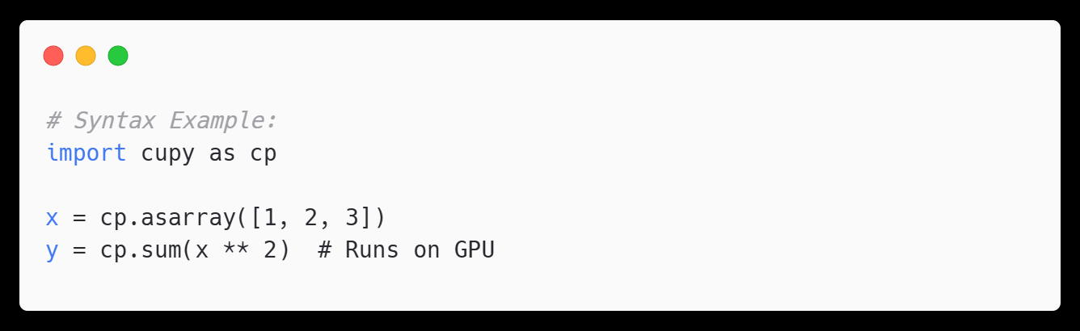
Introducing CuPy – NumPy on the GPU
What is CuPy?
CuPy is a GPU-accelerated drop-in replacement for NumPy.
Supports most NumPy functions but operates on GPU memory.
Why CuPy?
Supports CUDA kernels, GPU memory pools, and more.
Integrates well with custom deep learning frameworks.

Slide 24
Training MLPs on a single GPU
Step-by-Step Breakdown:
Move data to GPU once
Shuffle on GPU
Batch-wise forward pass using layers implemented with CuPy (e.g., DenseGPU).
Compute loss and gradients on GPU
Backpropagation remains fully on GPU.
X_gpu = cp.asarray(X)
idxs = cp.random.permutation(len(X_gpu))
diff = preds - yb
grad = (2 * diff / batch_size).reshape(-1, 1)

Slide 25
Key CuPy Concepts in the Training Code
Operation | CuPy Feature Used
cp.asarray() | GPU array creation
cp.random.permutation() | GPU-based shuffling
cp.sum() | GPU-reduced computation
cp.reshape(), cp.vstack() | GPU-friendly tensor reshaping

Slide 26
Why do we care?
Performance Gains
Training time drops significantly by avoiding CPU overhead.
CuPy allows parallel operations across batches natively on the GPU.
Clean Abstraction
Keeps the interface similar to NumPy.
Developers already familiar with NumPy can easily transition.
Scalable Design
Works well with mini-batching.
Prepares your codebase for scaling to multi-GPU setups.

